Slide 1

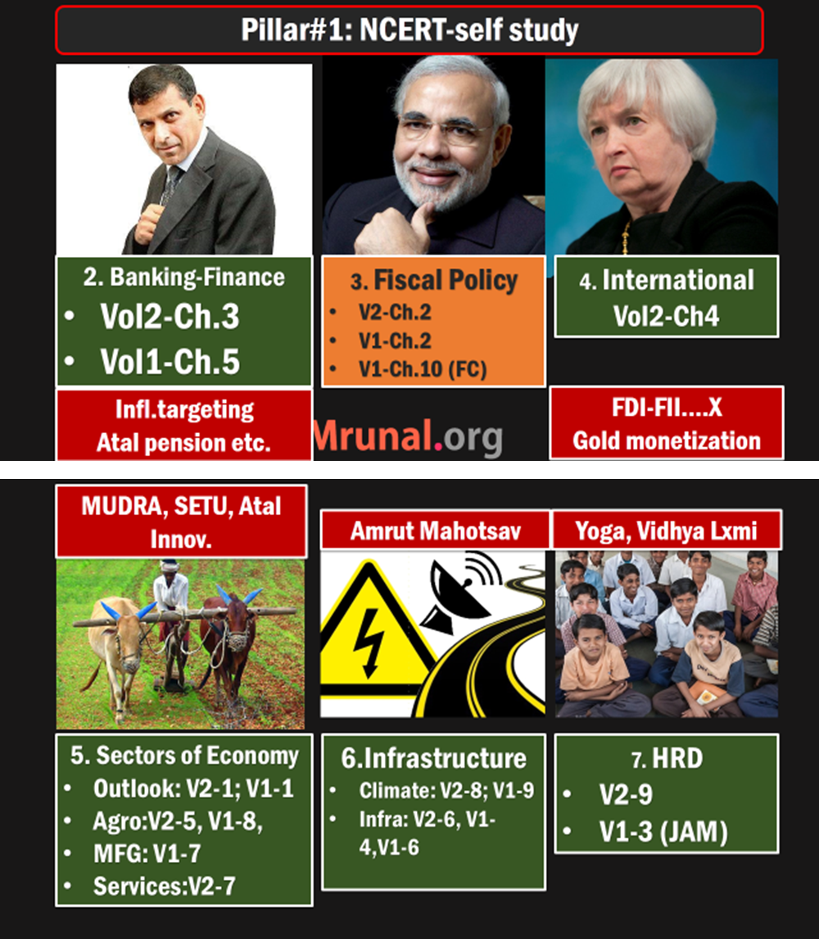
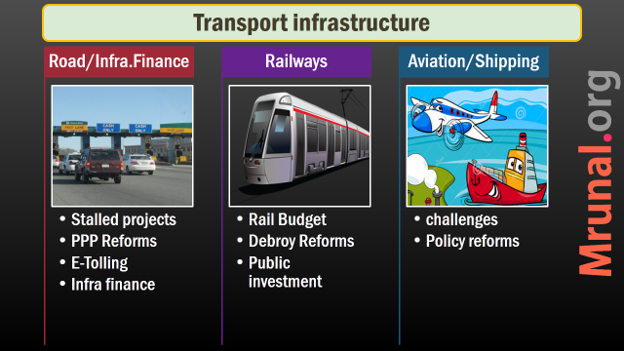
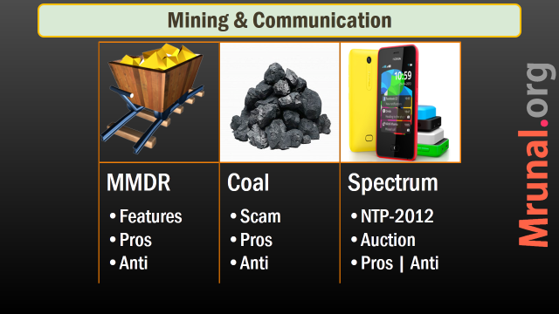

Slide 2
Mains GS3: Infrastructure
Infrastructure: Energy, Ports, Roads, Airports, Railways etc.
Investment Models

Slide 3
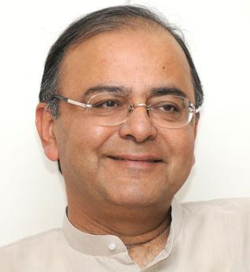
Amrut Mahotsav
Budget 2015
2022 - 1947 = 75 years of India's independence.
Union + State = team India, will implement following

Slide 4
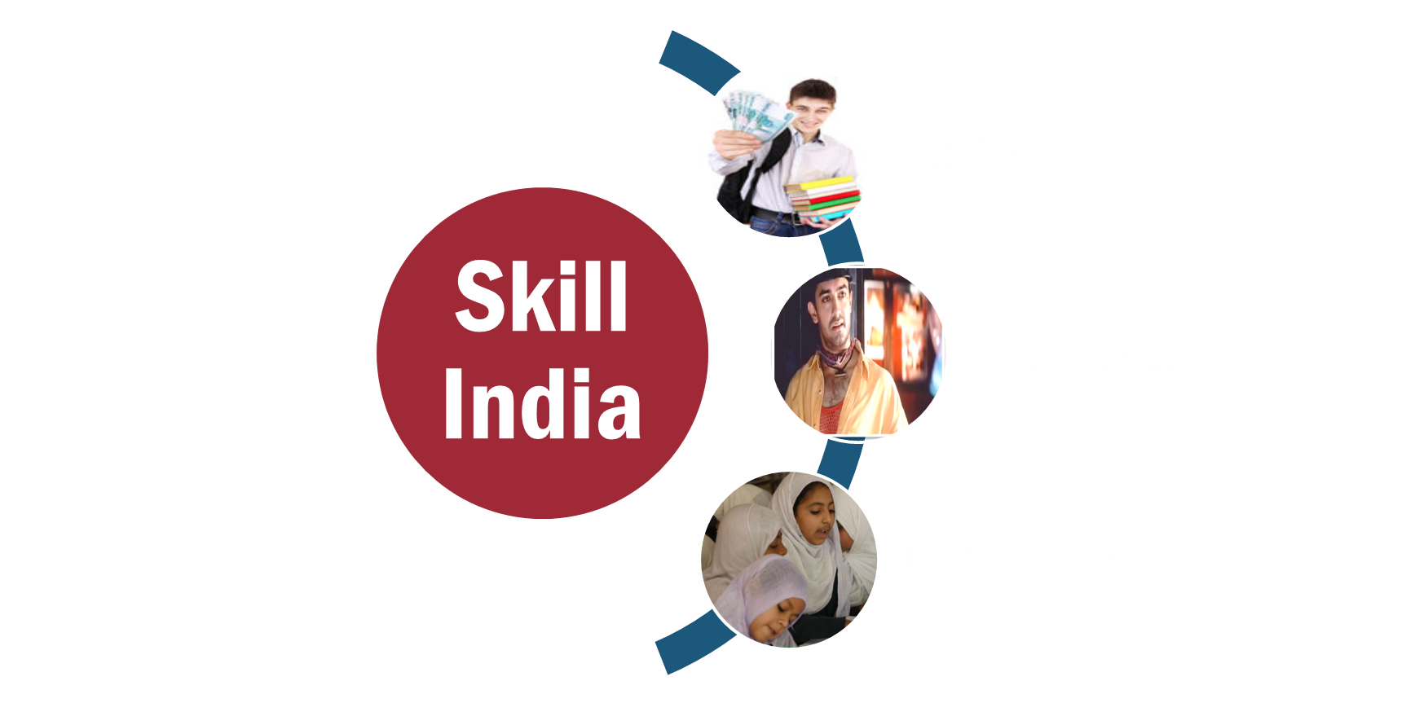

Amrut Mahotsav 2022: 6 pillars (1-3)
Housing
2 cr. urban
4 crore rural
24/7
Water, toilet, road,
electricity
Medcare
Jobs
1 member in each house
Skill India + make in India
housing for all

Slide 5
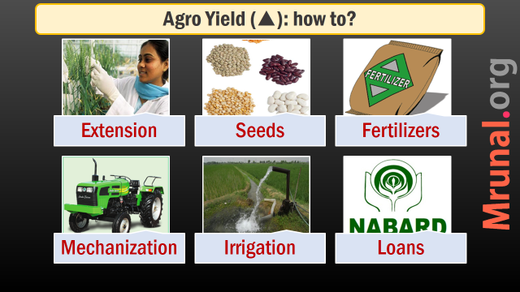
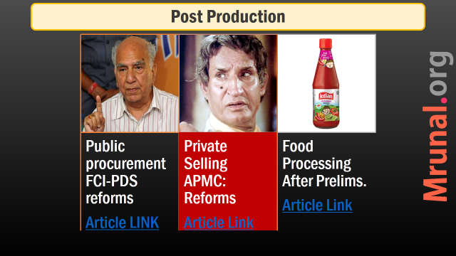
Amrut Mahotsav 2022: 6 pillars (2-6)
Edu
1 SSC school within 5 kms.
Agro
Improve irrigation
Value addition (food processing)
IT
Internet for All
NOFN: 2.5 lakh villages

Slide 6
Why infra?
Demand by
Population
High growth
High pressure on
Transport
Energy
If Poor infra
GDP bottleneck
Communication
Poverty
Essential service expensive
Notes:
environmentally sustainable infrastructure= inclusive growth

Slide 7
3 roles of Government in INFRA. Development?
Planning
Contracting
Regulating
To ensure Development of all regions
Complex PPP agreements
To prevent market failures & monopolies
Self..X
Inefficient
Fiscal deficit

Slide 8
Transport infrastructure
Road/Infra.Finance
Railways
Aviation/Shipping
Stalled projects
E-Tolling
PPP Reforms
Rail Budget
Debroy Reforms
Public investment
Policy reforms
challenges
Infra finance
Self study

Slide 9
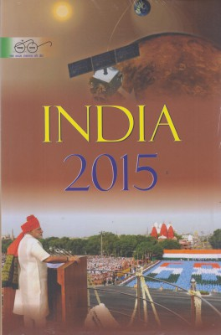
India Yearbook 2015
Ch.26: transport
829: 3 agencies for highway Management: NHAI, PWD, BRO
829: NHDP phases (numbers nope, only brief idea)
831: central road fund

Slide 10
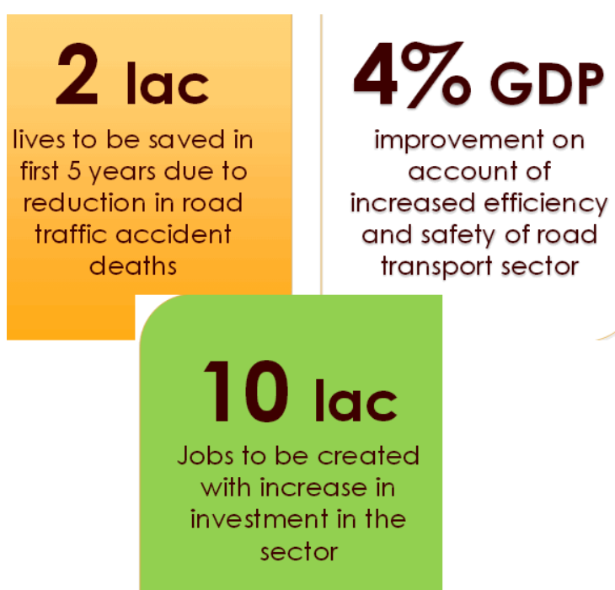
Road safety bill Article LINK

Slide 11
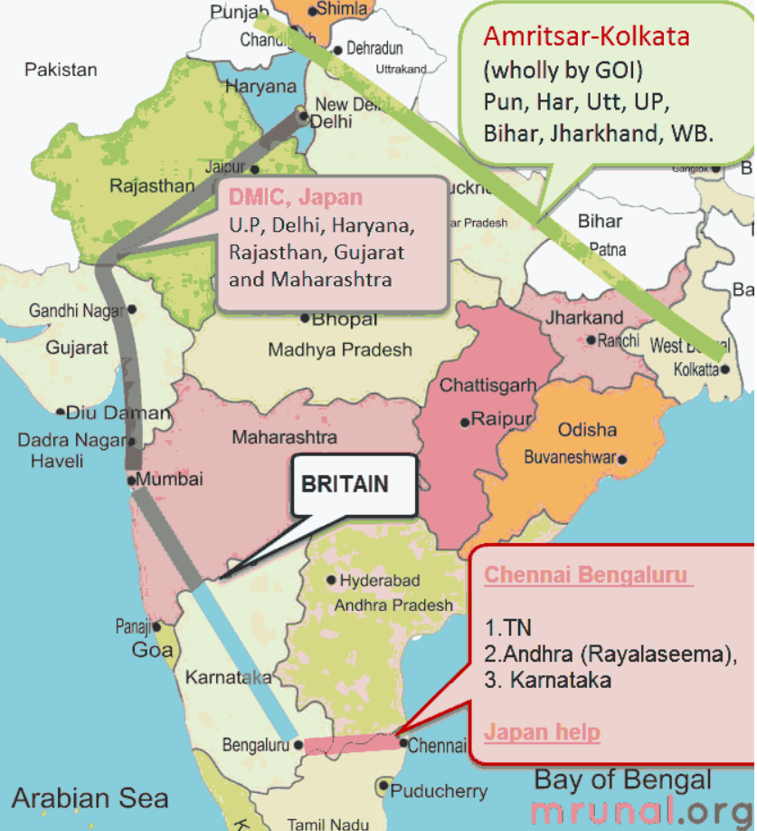
various corridors- Article link +IYB Page .492

Slide 12
Golden vs. Diamond quadrilateral
Golden Quadrilateral | Diamond quadrilateral
1999 | 2014
under NHAI | under Rail budget
To connect four main cities of India Delhi-Kolkata-Chennai-Mumbai. ~6000km length | To connect major metros through High Speed Rails.
(length wise, longest to shortest) Kolkata-Chennai Delhi Kolkata Delhi Mumbai Chennai Mumbai | Proposed routes Mumbai-Ahmedabad Howrah-Haldia New Delhi-Patna Hydrabad-Chennai

Slide 13
NHAI functions, financing: Article link
Name | Responsibility of | Connects
National Highways | Union Government | State capitals
Expressways (6-8 lane) | Union | Major Cities e.g. Abad-Baroda
State highways | State Government | State Capital to District HQ
district roads | Zila Parishad | District HQ to tehsil and Blocks
village roads | Gram Panchayat | Villages to neighboring towns

Slide 14
Transport infrastructure
Road/Infra.Finance
Railways
Aviation/Shipping
Stalled projects
E-Tolling
PPP Reforms
Rail Budget
Debroy Reforms
Public investment
Policy reforms
challenges
Infra finance
Self study

Slide 15
PPP in Airport
petipack
PPP Project
Greenfield
GMR Hyd. Intl. Airport (LTD)
Brownfield
Delhi
Mumbai
start / rebuild something where
some work is done already.

Slide 16
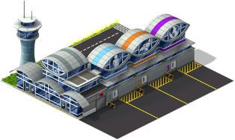
PPP in Airport
Debt
/Equity
Greenfield
GMR Hyd. Intl. Airport (LTD)
GMR: 63%
GOI: 13%
Andhra: 13%
Malaysia: 11%
Private (74%)
Public (26%)
JV/SPV
BOOT model: Build, Own, operate, TRANSFER
(transfer to public authority, once cost+interest recovered)
Notes:
Build, Own, Operate and Transfer (BOOT) basis.
SPV / JV formed
Private company given “concession” to build a public utility asset (road, bridge, dam etc)

Slide 17

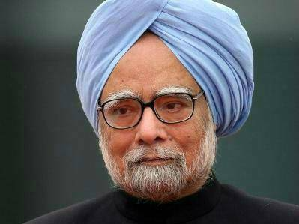
Public side (Govt.) 26%
Private side (GMR etc.)
74%
Impose taxes, Customs checking
Fix user fees
Security (Rs.130/passenger)
DGCA to give license
Build & maintain the airport
Water, sewage, sanitation, refueling, parking.
Collect user fees
Buy X-ray machine. CCTV etc.
Entertain state guests in VIP lounge

Slide 18
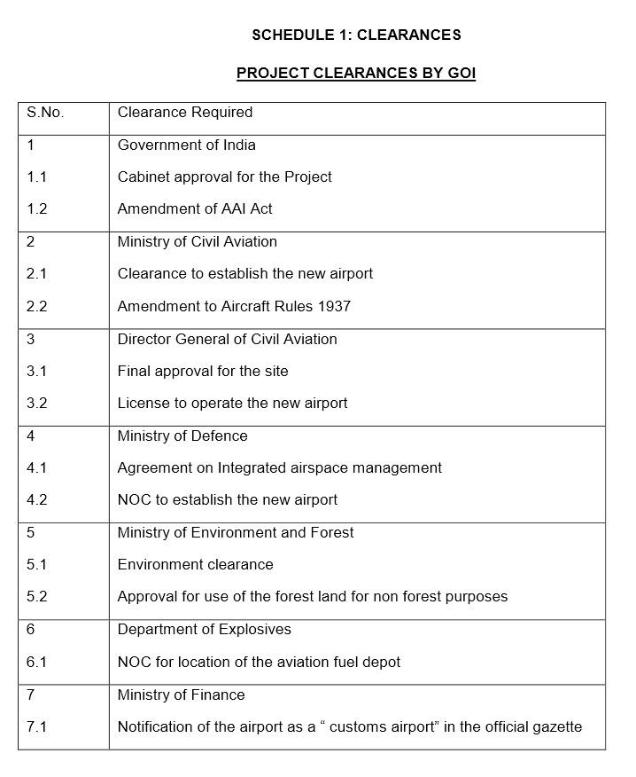
“NOT” ease of doing Biz: Clearances to run an airport
Commerce Min.

Slide 19
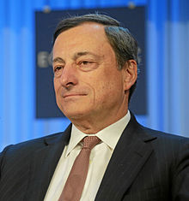
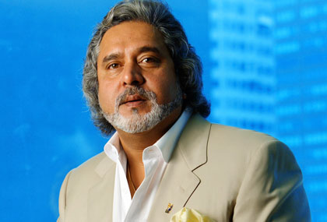
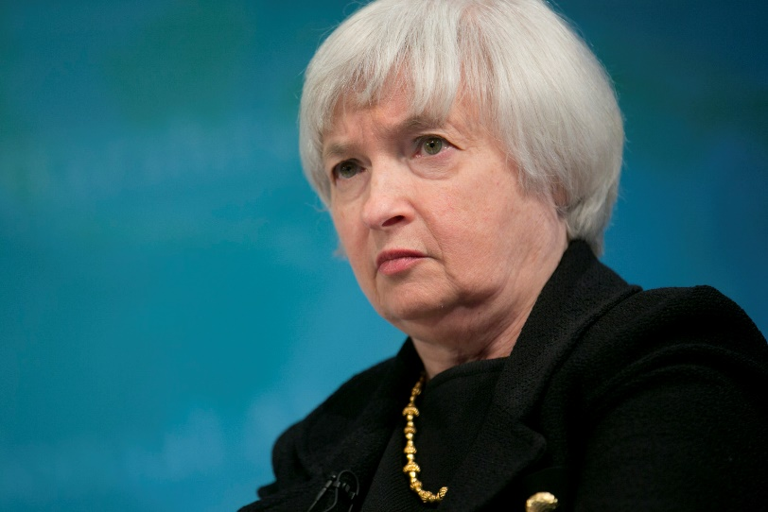
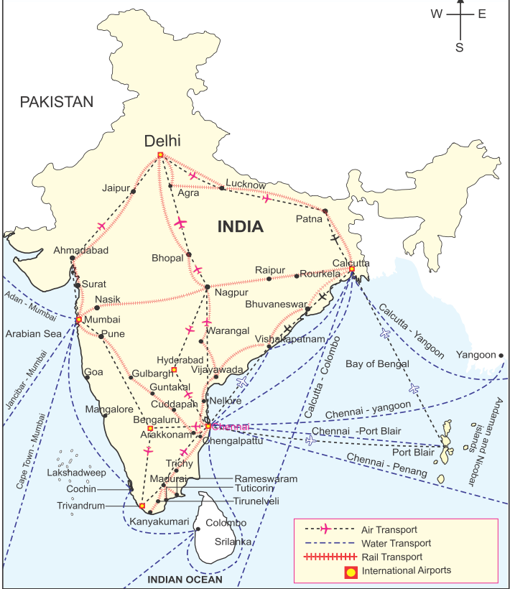
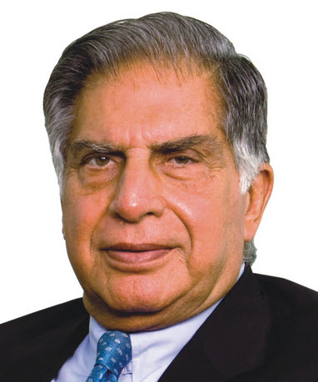
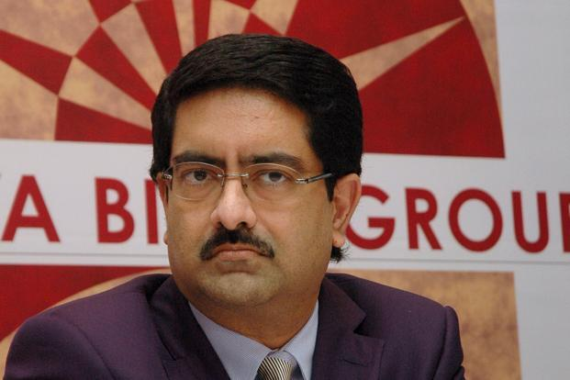
Banks not restructuring loan ☹
Global Slowdown
Govt. not renegotiating contracts: deadline/user charges not changed
+ environmental activism
Shipping, highway, airport, electricity
Revenue / User charges ▼
Notes:
Sea / highway / airport / electricity
Income flow = user charges
Economy slowdown = collection
Contractor Hopes to renegotiate with banks for loan restructuring and Government to ▲ user fees.
did not happen.

Slide 20
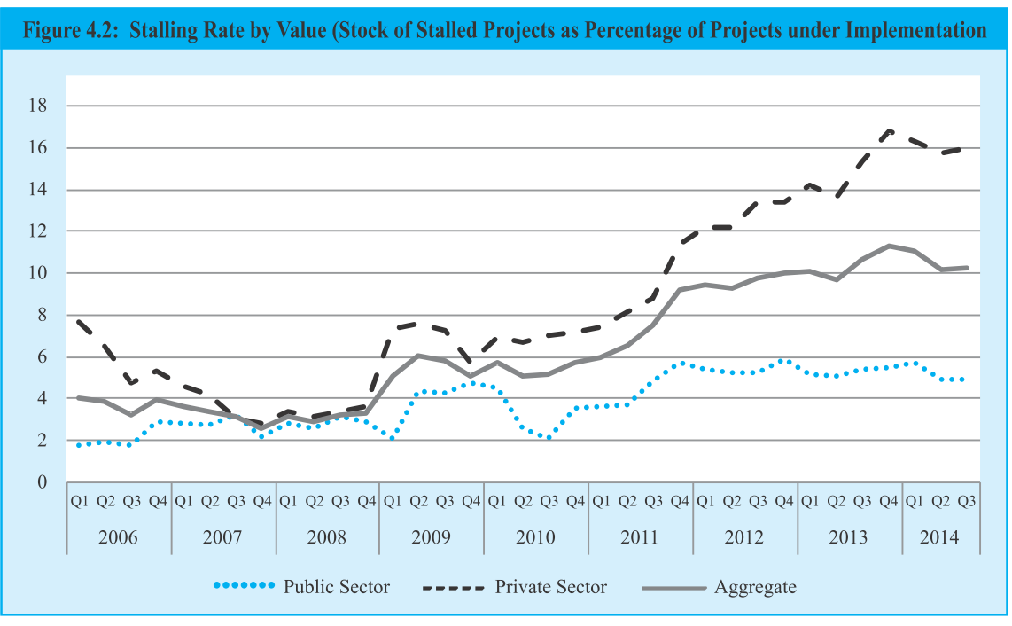

Slide 21
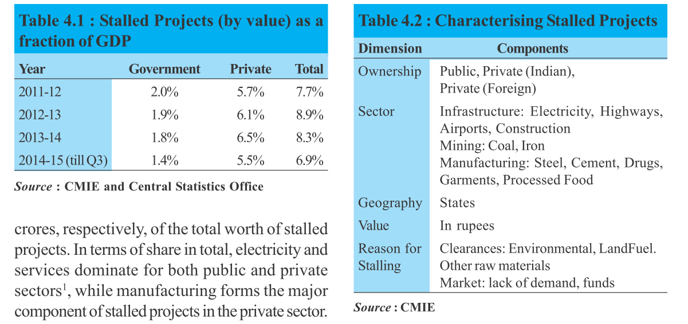

Slide 22
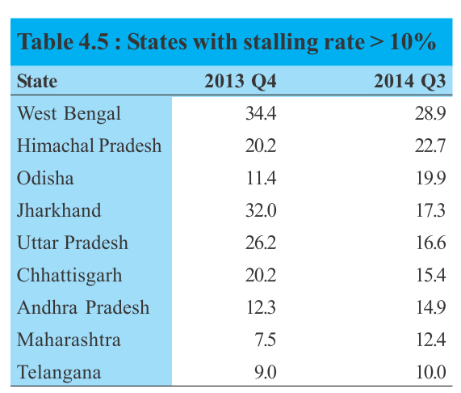
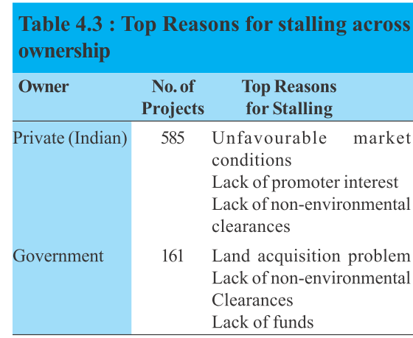

Slide 23
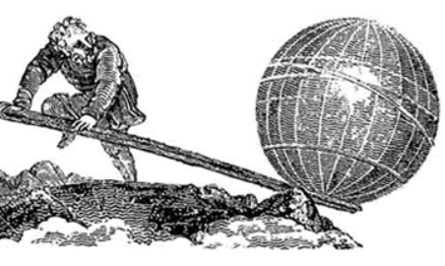
Ups & downs part of biz.cycle, then why problem?
“Give me a place to stand and with a lever I will move the whole world.” –Archimedes
Leverage: the advantage gained by using a “LEVER”.

Slide 24
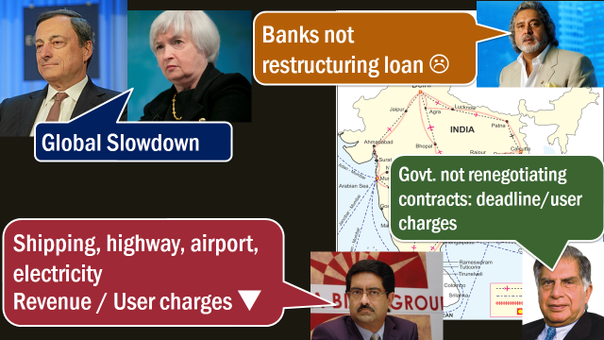


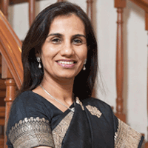
What if monthly income target is Rs.1 lakh
1 rickshaw
10,000 pm
9 rickshaw on EMI
Notes:
Companies that borrow too much and are overleveraged are at the risk of becoming bankrupt if their business does poorly.

Slide 25
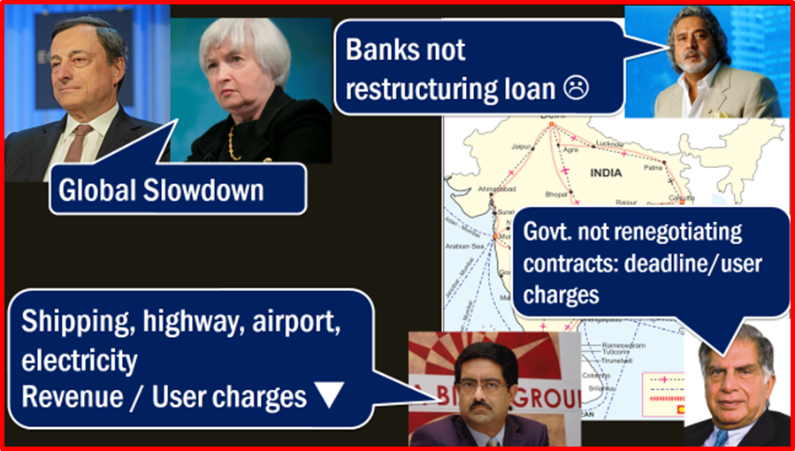
ICR
Overleveraged
Overleverage: Companies borrow too much @risk of becoming bankrupt if their business does poorly.
Debt / equity => financial leverage. Indian companies ratio high.
Interest coverage ratio (ICR)
3700 Indian cos have ICR < 1 => they can’t interest payment.

Slide 26
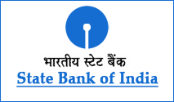
Debt Overhang
overleveraged
Existing debt so large
Profits gone to repay old loans.
Firm can’t et addl. Debt for future projects
80s: Japanese real estate boom same scene.
Most debt from banks=> NPA.

Slide 27
But why did companies overleverage?
Hoped global recovery
Corruption: weak cos. selected
Internalization of politics / “Too big to Fail”

Slide 28
Bureaucrats reluctant
problems
If project fail => no penalty
If bureaucrat renegotiates terms e.g.
▲ User charges
▼ Share to Government.
▲ deadline for project completion
BUT Revamp => graft investigation, CAG / media /PIL scrutiny.
2G/coal => reluctance to clear files

Slide 29
Mains/Interview: Road & infra. finance
Q. Problem of stalled infrastructure projects in India, is a manifestation of market failure & regulatory failure. Discuss.
Market: overleveraged firms, "too big to fail" mentality, internalization of politics
Regulatory: Lowest bidder / highest sharer, Stable policy on EIA/Environment clearance, reluctant bureaucrats, exit mechanism cumbersome

Slide 30

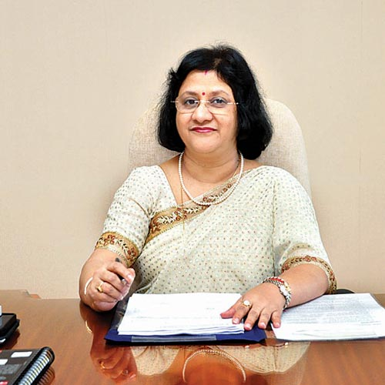
Reform: 3P-India to make better PPP contracts
Overleveraged firms bided for PPP projects
Slowdown in
Economy
Environment
clearance
Can’t finish
Project on
deadline
Want higher toll
to keep same
profit margin
Bank NPA increased
Doesn’t modify PPP contract
OR Wants BRIBES
OR takes no action due
to judicial / media scrutiny

Slide 31

3P-India
Infra-PPP
budget 2014: 500 cr. To setup
Last update: March 2015- cabinet deferred decision because Jaitley out of town.
3P India inst. To make better contracts for PPP projects
Example: Traffic trigger, Re-equilibrium discount

Slide 32
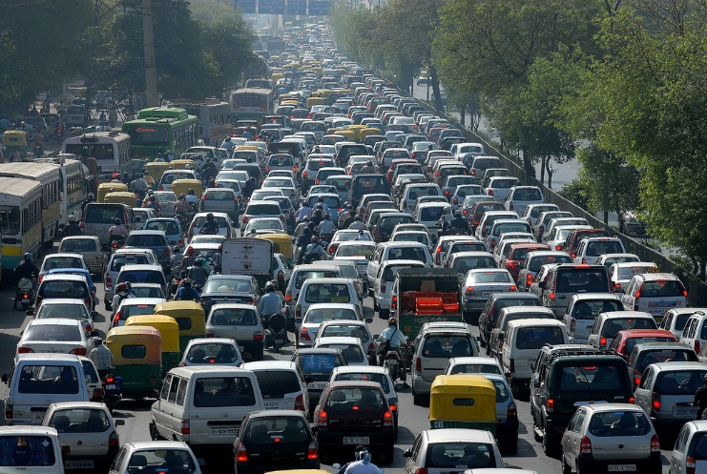
Traffic Trigger
Re-equilibrium discount
OTHERWISE
Reduce toll fees
for not improving service
More traffic=> expand highway
To ensure minimum service

Slide 33

Electronic Toll WHY?
Roads
All India uniform rate….X
Overcharging, underreporting: 88k crores lost.
Congestion @toll booth: 60 k crores lost. (IIM-C)
Indian highways Management Company ltd. to manage E-tolling
Revenues => escrow account. (no underreporting /cheating possible)

Slide 34
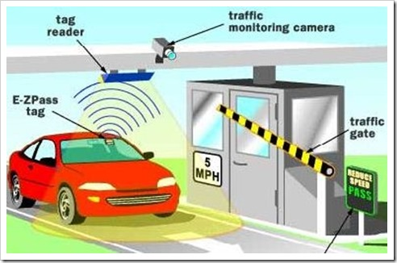
Electronic Toll HOW?
roads
(RFID) Fastag=> ICICI prepaid
NH8: Mumbai to Delhi 26 toll plaza

Slide 35
Electronic Toll Timeline?
Roads
2010: Nilekani recommends RFID Radio freq. identification
2014: Started from April
Compulsory for new highway projects
Installed at 55+ toll plazas @ Haryana, Rajasthan, MP, Gujarat & Maharashtra.
But awareness very low. Not many using it.

Slide 36
Road projects
problems
1st Contractor = Development
2nd Contractor = maintenance
1st will use substandard material to increase profits
Solution: same contractor be responsible for both Development and maintenance.

Slide 37
Transport infrastructure
Road/Infra.Finance
Railways
Aviation/Shipping
Stalled projects
E-Tolling
Rail Budget
Debroy Reforms
Public investment
Policy reforms
challenges
Bidding & infra. Finance
PPP Reforms

Slide 38
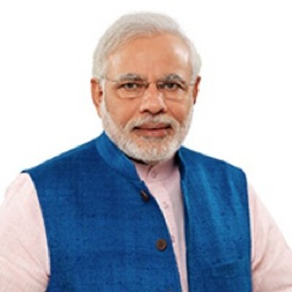
Private infra. (585)
Public (181)
Stalled projects (7L Cr.)
Mfg.
Mining
electricity
Stalled projects: (1.8L Cr.)
Infra
Airport Development
Road
shipping.

Slide 39
Private infra. Projects
Public Projects
Credit bubble of overleveraged firms
Can’t renego. PPP
Electricity: lack of coal supply
Macroeconomic slowdown: Less demand- less revenue.
Regulatory clearance not given on time
State vs. union clearances.

Slide 40
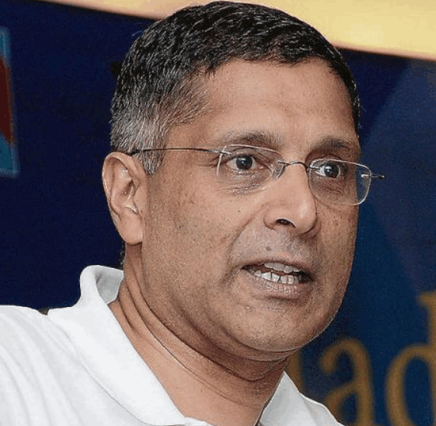
Survey Solutions?
Stalled
Independent Renegotiation Committee: to revamp PPP contracts.
Ease of doing biz.= faster clearance.

Slide 41
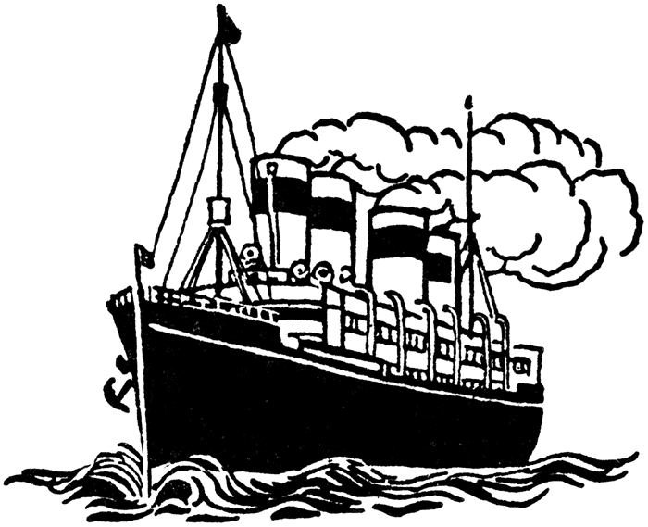
Customer service??
problems
Sea / airport Development projects
Bidder who agrees to share highest % with Government, gets contract
No conditions on customer service.

Slide 42

Power/ Electricity Projects
problems
Ultra mega power projects (UMPP)
Local Coal ▼ (envi. + cyclones + labour unrest)
Foreign coal import ▲
Rupee ▼ (Fed tapering)
End result= unviable biz. Coz can’t ▲ user fees

Slide 43
Power/ Electricity Projects
Solution
PPP contracts- link user fees & Government share with
Inflation
Fuel prices
Exchange rates.

Slide 44
Bidding
New projects
Electricity project: Reverse bidding; Efficiency + Capacity parameters. (More under Coal auction L7/P2.pptx)
Least present value of revenue (LPVR) contract => prevents opportunistic bidding by overleveraged firms.
if failed then Reform bankruptcy and exit mechanisms, let healthier firms takeover

Slide 45

financing
Infrastructure
SEBI: Convert Debt to equity for viable projects. (REF: L2/P1.pptx)
Convert debt to Long term bullet bonds
Can’t be redeemed early
(Principal +interest) paid @maturity
Long term infra. Project, NHAI=> insurance, pension firms.
Promote REITs, INVITS, Muni.bonds, IDF etc. (more in urban infra.lecture)

Slide 46
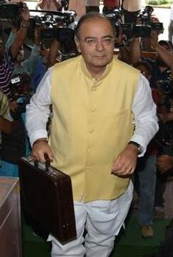
Budget 2015 provisions
NIIF
National Investment and Infrastructure Fund (NIIF)
Annual flow of 20k.
Bonds
Tax free bonds for rail, road, irrigation projects.
Ports
Turn public sector ports under companies act.
Will help getting more investment.
Power
5 UMPP x 4000MW each.
Heritage sites
Funds to improve tourism-infra there.

Slide 47
Mains / Interview: Road & infra. Finance
Q. Suggest the ways to revamp PPP contracts & regulatory framework to address the issue of Infrastructure slowdown in India.
User charges link with inflation, exchange rates etc.
E-tolling => escrow account.
same co. for construction & maintenance.
LPVR to prevent overleveraged firms
Finance: Bankruptcy, quick exit, bullet bonds, debt to equity.
3P-India, independent renego. Committee

Slide 48
Transport infrastructure
Road/Infra.Finance
Railways
Aviation/Shipping
Stalled projects
E-Tolling
PPP Reforms
Rail Budget
Debroy Reforms
Public investment
Policy reforms
challenges
Infra. Bidding, financing
Self Study

Slide 49
Railways Article Link
British legacy: WHO? When? Where?
Rail budget: Acworth Committee?
Types of gauges- width, length
Types of Trains-speed, area
Environment: Biodiesel, Biotoilets, Green Curtain

Slide 50
India Yearbook 2015
Ch.26: transport
827: Rail zones (non-UPSC)
828: Rail PSUs

Slide 51
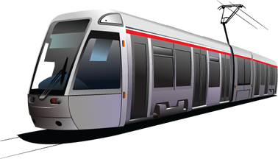
numbers
Railways
20k trains daily
2 cr passengers daily
30 lakh tone freight daily
13 lakh employed

Slide 52
Self-study: Railway achievements 2014
Udhampur-Katra broad gauge.
Meghalaya gets first rail connectivity.
Study for High speed Bullet Trains on Mumbai-Ahmedabad corridor, part of Diamond Quadrilateral network.
Next Generation e-ticketing(NgeT) application. By Central Railway Information Centre (CRIS)
Premium special trains under the dynamic fare system
roof top solar plants.
Wifi @Bengaluru and Delhi.
E-catering service by Indian Railways Catering and Tourism Corporation
MoU with China for training personnel in heavy haul ops, higher speed, rail university
Coal transport projects @Jharkhand, Odisha, and Chhattisgarh
Semi-high speed trains at 160/200 kmph. In 9 corridors.

Slide 53
Railways Budget 2015
Service
Modi Pet
Ticket Selling
Sp. routes
R&D, ICT
Speed

Slide 54
Rail budget 2015
speed, scale, service and safety, all on one track.
▲ freight rates on coal, iron ore and steel= ~4k crores. Counter: will hurt Make in India + Inflation in cement, coal, steel, iron ore.
Passenger fares changed? No
Diesel prices ▼ but ticket prices not. Hoping to use the money for better amnesties.
New trains announced? No

Slide 55
Rail Budget’15 service focus
Services improvement focus
Passenger amenities fund ▲ by 67%
SMS alerts for train timings.
Wi-Fi facility in 400 stations.
user-friendly ladders for upper berths.
17,000 bio-toilets.
Cameras for women travelers, from Nirbhaya fund. Counter: international studies show no correlation between crime rate and camera.

Slide 56
Rail Budget’15 speed targets
Five year plan: increase speed by 50% and loading to 1.5 billion tonnes.
High speed train corridors at Mumbai-Ahmedabad highspeed corridor, Chennai-Bengaluru-Mysuru high-speed corridor.
Silent on bullet trains. But will increase speed of other trains.

Slide 57
Rail Budget’15 Ticket selling
Book tickets 4 months in advance.
PH-travellers can buy e-tickets at discounted price with one time registration.
developing a multilingual e-ticketing portal.
Travelling ticket examiners (TTEs) to get handheld devices to verify tickets and download charts.

Slide 58
Rail Budget’15 R&D/E-gov.
bar coded/RFID tracking in freight trains.
Centrally-managed Railway Display Network in over 2000 stations in the next two years
IIT-Kanpur to design radio signal for warnings at unmanned level crossings.
IIT Varansi to get "Malaviya chair" for rail tech.

Slide 59
Rail Budget’15 special trains
IRCTC's special scheme “Kisan Yatra”: farmers to visit farming and marketing info. centres.
Will replicate Konkan Railway tourism by training autorickshaw and taxi operators as tourist guides at several major tourist centres.
Gandhi circuit to mark the occasion of 100 years of the return of Mahatma Gandhi to India from South Africa.

Slide 60
Rail Budget’15 Modi Pet Projects
Railway to promote Swachh Bharat, Make in India, and Digital India.
Yoga training for Rail staff.

Slide 61
Transport infrastructure
Road/Infra.Finance
Railways
Aviation/Shipping
Stalled projects
E-Tolling
PPP Reforms
Rail Budget
Debroy Reforms
Public investment
Policy reforms
challenges
Infra.financing

Slide 62
Chinese Railways better because
Investment 11x higher
JV with coal cos. & provincial Government
90,000km track (64k India)
Speed kmph: 300 (P) | 100 (F); India ~25kmph
Corporatized railways: debt equity

Slide 63
Indian railways bogus because
Cross subsidization, but no service improvement
Same tracks for goods & passengers = slow.
Wagon productivity lowest than China, Russia
Slow speed=Trade competitiveness ▼

Slide 64
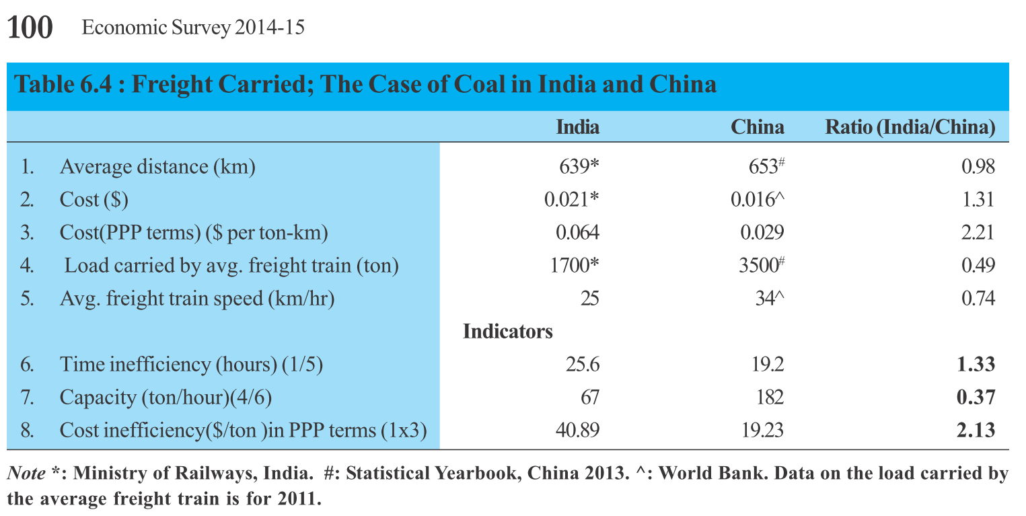
Coal transport: India vs China

Slide 65
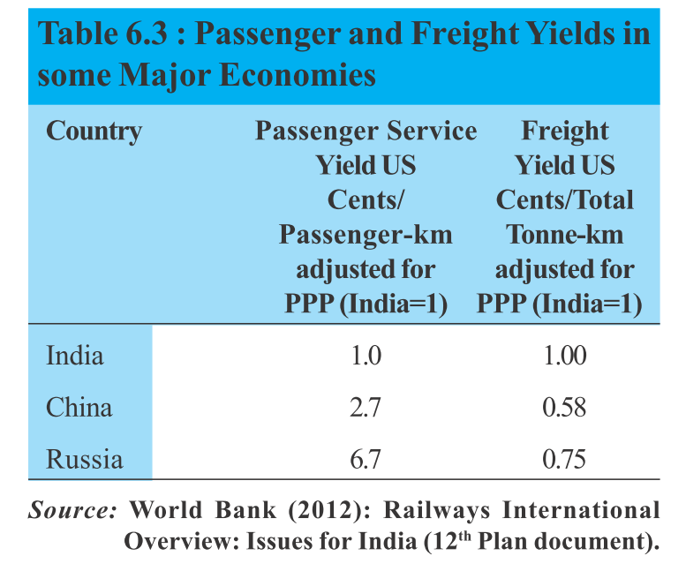
Passenger vs. Freight transport

Slide 66
Kayakalp
Rail budget
Innovation council called “Kayakalp” for
business re-engineering
spirit of innovation
Chairman: Ratan Tata. Rail trade union leaders also included
Mar. 2015: Terms yet to be finalized

Slide 67
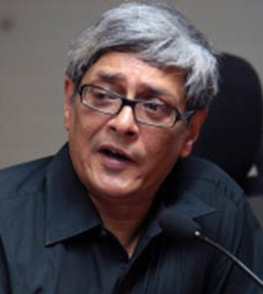
Bibek Debroy Committee
Rail Reforms
Debroy: noted economist, Niti Ayog full time member.
high-level committee
Restructuring rail board/ ministry
Mobilize rail resources
Sep2014 formed. Interim Report on March 2015

Slide 68

Bibek Debroy HRM
Rail Reforms
Technical (IRTechS)
IRSE
IRSSE
IRSEE
IRSME
IRSS
Non-technical (IRLogS)
IRAS
IRPS
IRTS

Slide 69
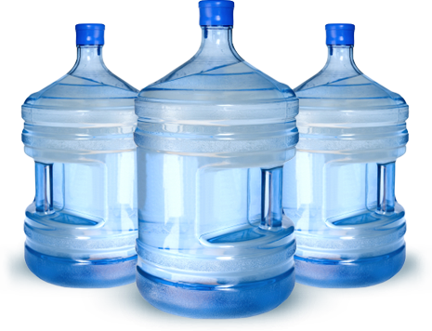
Bibek Debroy outsourcing
Rail Reforms
▼ no. of railway zones /divisions.
Shift to commercial accounting to find rate of return in each project
Distance from non-core areas: police force, schools, hospitals, water bottling, museum etc.
Outsource security to state police.
Outsource education to Kendriya Vidyalaya Sangathana (KVS)
Notes:
Accounting: present complex, hard to figure rate of return on a project
Give subsidy to learn in private institutions.

Slide 70

Bibek Debroy Tickets
Rail Reforms
Independent "Railway Regulatory Authority of India (RRAI)" for ticket prices, service quality etc. with independent budget, quasijudicial powers.
No more cross subsidization. The freight rates be left to market

Slide 71
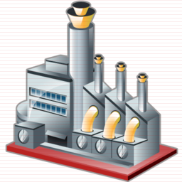
Bibek Debroy factories
Rail Reforms
SPV: Indian railway mfg. company. Government owned but free to decide work and wages. Build Coaches and locomotives.
Separate track holding company. So even private players can access tracks. (E.g. track / train repair)

Slide 72

Bibek Debroy JV, SPV
Rail Reforms
Sub urban lines- states to contribute money & personnel via Joint venture
Merge rail budget with Gen. Budget & Rail ministry to transport ministry.
Setup Investment Committee with RBI, SEBI etc. Get money from InviTs, NBFCs

Slide 73
Bibek Debroy Committee: Rail restructuring
▼ org.
▼ non-core
New body
JV/SPV/merger
Commercial accounting
State police
KVS
no cross subsidization
Rail to Gen.Budget
Finance
Urban rail
Mfg.
Union ministries
Investment Committee
services
zones
fares

Slide 74
Transport infrastructure
Road/Infra.Finance
Railways
Aviation/Shipping
Stalled projects
E-Tolling
PPP Reforms
Rail Budget
Debroy Reforms
Public investment
Policy reforms
challenges
Infra.financing

Slide 75
Public investment?
Why?
Infra. Is import (slide 3 to 6)
Infra requires investment
Banks: NPA high
Corporates: overleveraged balance sheets /debt overhang.

Slide 76
Public investment?
Why?
Can generate largest spillovers (IMF)
Short run:
Aggregate demand boosted
Crowds in private investment due to complementary nature of infrastructure services
Long run: feeds into productive capacity of the economy

Slide 77
Public investment in infra. BUT WHERE?
Aviation
Private sufficient
Highways
NHDP, PMGSY done good.
States also spending
Railways
States..no
Union only 5% of total budget outlay
AirIndia: throwing good money after bad money

Slide 78
Why rail better than road?
Transport cost (Rs.2/ton/kms)
Moving goods: 70-90% energy less
Moving people: 20% energy less.
GHG emission ▼
Coal transport to steel /power plants: China 3 x faster
India 2x expensive yet slower.

Slide 79
USA 44% goods moved through railways

Slide 80
Mains/ Interview
Public investment, especially in the railways, can play an important role to revive growth and promote Make in India. Discuss.

Slide 81
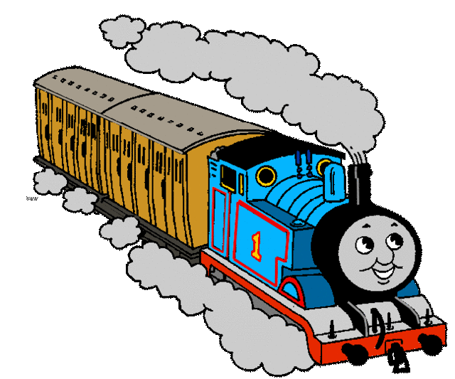
Invest in railways
why
1850s: EIC+Empire invested in railway expansion. Market integrated, revenue boosted.
DFC, golden-diamond quadrilaterals, industrial corridors = make in India.
1 rupee investment = increase the output of economy by 5+ rupees.

Slide 82
Invest in railways
HOW?
Short term: gen. budget support but linked with performance.
Long term: Equity finance to corporatized units e.g. IRCTC + Offshore Rupee Bonds

Slide 83
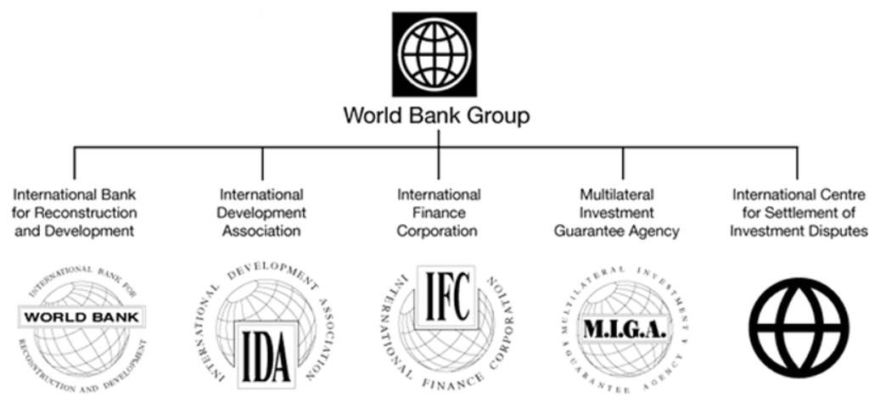
World Bank group=> IFC

Slide 84
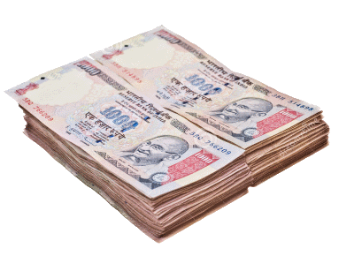
Offshore rupee bonds
Railways
World Bank group=> IFC
“Masala bonds” (Offshore Rupee bonds) listed @London Stock exchange.
Masala bcoz Indian spices
Money to Indian companies.
In news: Indian Railways Finance Corp to get $1 billion debt finance via Masala bonds.

Slide 85
Transport infrastructure
Road/Infra.Finance
Railways
Aviation/Shipping
Stalled projects
E-Tolling
PPP Reforms
Rail Budget
Debroy Reforms
Public investment
Policy reforms
challenges
Infra.financing

Slide 86
Aviation
Article link
AAI vs DGCA: function, jurisdiction
FDI limits
New players: AirAsia / Vistara
Gagan, IRNSS LINK

Slide 87
India Yearbook 2015
Ch.26: transport
846: AirIndia’s subsidiary companies
847-48: Pawan Hans

Slide 88
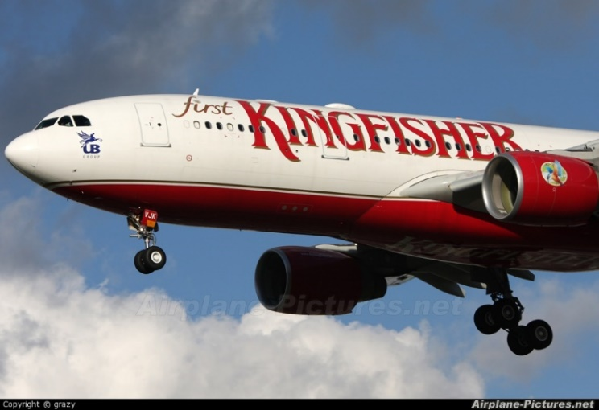
Draft Aviation Policy 2014
Transport
List AAI, Pawans Helicopters on stock exchange=> later disinvestment can be done.
AirIndia privatization not yet.
6 metropolitan airports to be developed into international hubs
Total ~130 airports today. Create more via PPP. 4 in phase 1

Slide 89
Draft Aviation Policy 2014
Transport
ATF 40% expensive that elsewhere, due to high taxes. Fix it.
Incentivize MRO - maintenance, repair, overhaul. (land+taxes)
create more jobs in aviation sectors. 100 jobs in aviation =600+ overall.
Boost NE connectivity =>no frills airport.

Slide 90
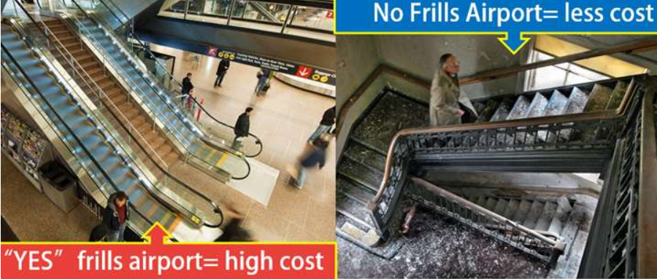
No frills Airports

Slide 91
No Frills Airport
Aviation
Need Air connectivity to backward regions but Low profitability
No frills by AAI: no lounges, no conveyor belts, single storey building
Build in 2-3 years, <100 crore investment. Approved @5 cities in Arun, Raj, Odi, Karna.

Slide 92
Misc.
Aviation
Predatory pricing by spice jet. DGCA notice. MP want full price control, Government not in favor.
State VAT on ATF: 30-35% need to reduce. (under GST, fuel kept out)
4 PPP projects @Chennai, Kolkata, Ahmedabad, and Jaipur
Make Greenfield @Tourist places, T2, T3 cities

Slide 93
Transport infrastructure
Road/Infra.Finance
Railways
Aviation/Shipping
Stalled projects
E-Tolling
PPP Reforms
Rail Budget
Debroy Reforms
Public investment
Policy reforms
challenges
Infra.financing

Slide 94
Shipping
Article Link
Major ports vs. cost, which are natural, riverine?
Major port vs. Minor ports
Baltic dry index: (L5/P5.pptx)

Slide 95
India Yearbook 2015
Ch.26: transport
837: Shipping corp. of India basics
839 onwards: Inland water transport- map locations
Ch.27: Water resources
Namami Gange
Interstate Disputes
Intl. cooperation

Slide 96
good
Shipping
India's foreign trade: 95% by volume and 68% by value
leading ship- breaking destination.
major supplier of seafarers to the world: 60,000 crew (seamen) and 44,500 officers in 2014.

Slide 97
problems
Shipping
Not supplying enough maritime personnel compared to our demographic dividend.
Harbors small, ships offload to Sri Lanka.
Avg. ship age 15 years
Hv2 replace Ships => loan issues
Baltic dry index low (L5/P5.pptx)

Slide 98
Reforms done
Shipping
Allowed Indian cos. To buy ships abroad and flag them in the country of their convenience;
No custom / excise on fuels used in Indian flag vessels.
Allowed ECB
Ship repair units don't need to register with DG shipping.

Slide 99
Sagar Mala
Shipping
No ease of doing biz: 150 documents, 4 days clearance, 12 type of taxes.
Large vessels cannot dock; poor warehousing;
12 ports' tonnage=Shanghai alone.
2003: Vajpayee Government. NHAI like Sagarmala Development authority
$$ via maritime cess, PPI, FDI (100% in port Development)
Better ports, inland water, coastal shipping

Slide 100
Sethu Samudram
Shipping
shipping canal between Palk bay and Mannar gulf to reduce time and fuel.
Anti: will hurt biodiversity and religious sentiments.

Slide 101
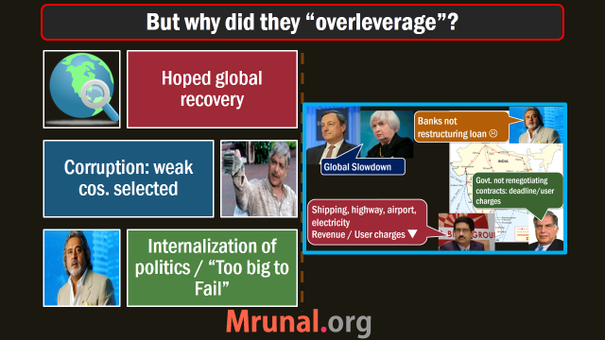
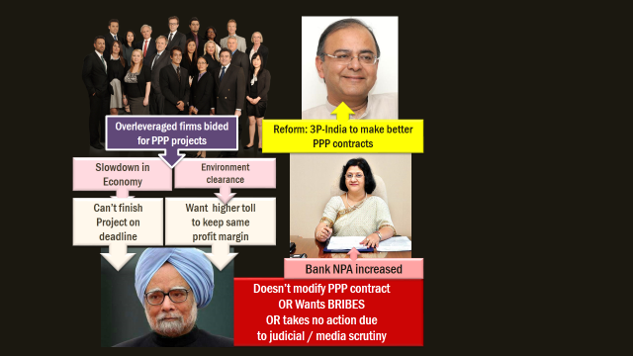
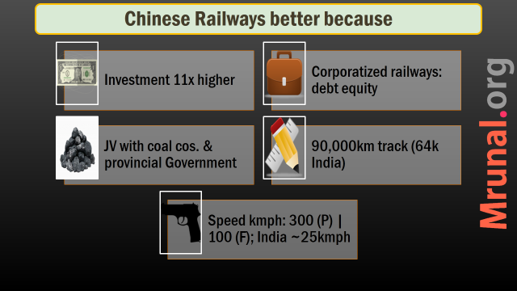
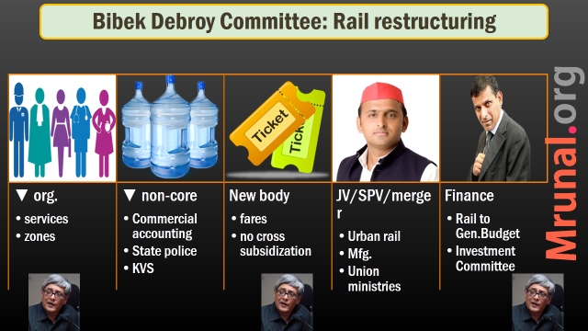

Slide 102


